Slide 1

Management Information Systems: Managing the Digital Firm
Sixteenth Edition
Chapter 6
Foundations of Business Intelligence: Databases and Information Management
Copyright © 2020, 2018, 2016 Pearson Education, Inc. All Rights Reserved
Notes:
If this PowerPoint presentation contains mathematical equations, you may need to check that your computer has the following installed:
1) MathType Plugin
2) Math Player (free versions available)
3) NVDA Reader (free versions available)

Slide 2
Learning Objectives
6.1 What are the problems of managing data resources in a traditional file environment?
6.2 What are the major capabilities of database management systems (D B M S), and why is a relational D B M S so powerful?
6.3 What are the principal tools and technologies for accessing information from databases to improve business performance and decision making?
6.4 Why are information policy, data administration, and data quality assurance essential for managing the firm’s data resources?
6.5 How will MIS help my career?
Notes:
This chapter discusses the role of databases for managing a firm’s data and providing the foundation for business intelligence. Ask students to describe any databases they have encountered or used at work or in their personal use on the web. For example, Google and Amazon are database-driven websites, as are travel reservation websites, Facebook, and, of course, iTunes. Ask students why these sites are driven by databases—what is it about databases that makes the creation and use of these sites more efficient?

Slide 3
Video Cases
Case 1: Dubuque Uses Cloud Computing and Sensors to Build a Smarter City
Case 2: Brooks Brothers Closes In on Omnichannel Retail
Case 3: Maruti Suzuki Business Intelligence and Enterprise Databases

Slide 4
Data Management Helps the Charlotte Hornets Learn More About Their Fans
Problem
Large volumes of data in isolated databases
Outdated data management technology
Solutions
S A P H A N A
Data warehouse
FanTracker
Illustrates the importance of data management for better decision making and customer analysis

Slide 5
File Organization Terms and Concepts
Database: Group of related files
File: Group of records of same type
Record: Group of related fields
Field: Group of characters as word(s) or number(s)
Entity: Person, place, thing on which we store information
Attribute: Each characteristic, or quality, describing entity
Notes:
This slide describes a hierarchy of data that is used to store information in a database, progressing from the database as the top-level holder of information down through the field, which stores information about an entity’s attribute. This hierarchy is illustrated by the graphic on the next slide. Ask students to come up with some other entities that might be found in a university database (Student, Professor, etc.). What attributes (characteristics) would be important to store in the database?

Slide 6
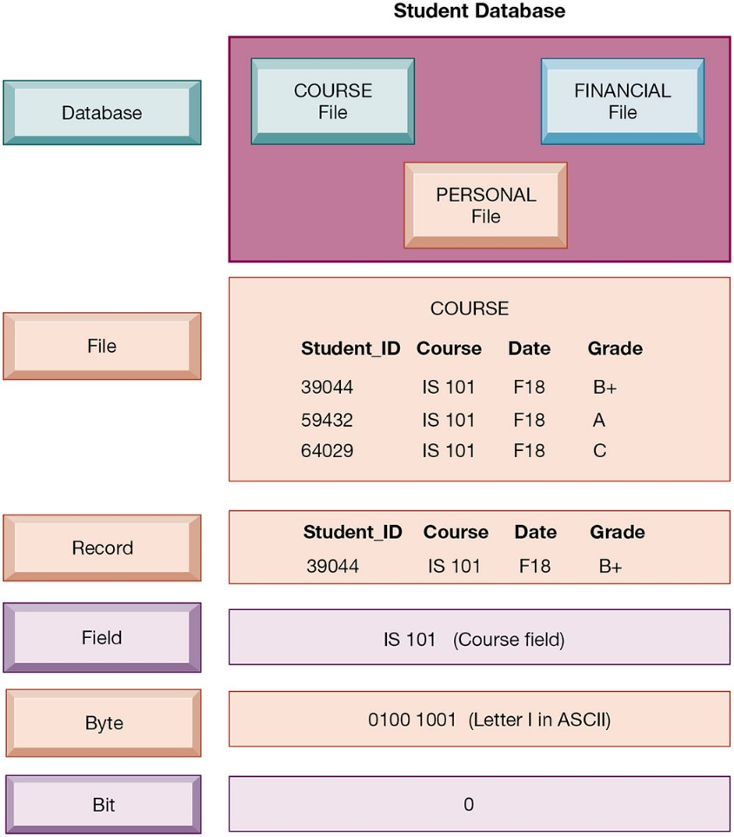
Figure 6.1 The Data Hierarchy
Notes:
Figure 6.1, Page 214.
A computer system organizes data in a hierarchy that starts with the bit, which represents either a 0 or a 1. Bits can be grouped to form a byte to represent one character, number, or symbol. Bytes can be grouped to form a field, and related fields can be grouped to form a record. Related records can be collected to form a file, and related files can be organized into a database.
This graphic illustrates the hierarchy of data found in a database. It shows the student course file grouped with files on students’ personal histories and financial backgrounds that form the student database. It illustrates what data is found at each hierarchical level, from the database level down. Making up the smallest information unit, the field, are smaller units of data, common to all applications: bits and bytes. A bit stores a single binary digit, 0 or 1, and a byte stores a group of digits to represent a single character, number, or other symbol.
Full description: A Data hierarchy for a student database includes the following sections. Database, including Course file, Financial file, and Personal file. File, an example of which is a Course file including Student I D's, Courses, Dates, and Grades. Record. Field, such as I S 1 oh 1, which is a Course field. Byte, such as oh 1 zero zero 1 zero zero 1, which is the Letter I in A S C I I. Bit, such as zero.

Slide 7
Problems with the Traditional File Environment
Files maintained separately by different departments
Data redundancy
Data inconsistency
Program-data dependence
Lack of flexibility
Poor security
Lack of data sharing and availability
Notes:
This slide discusses the problems in data management that occur in a traditional file environment. In a traditional file environment, different functions in the business (accounting, finance, HR, etc.) maintained their own separate files and databases.
Ask students to describe further why data redundancy and inconsistency pose problems? What kinds of problems happen when data is redundant or inconsistent. Ask students to give an example of program-data dependence. What makes the traditional file environment inflexible?

Slide 8
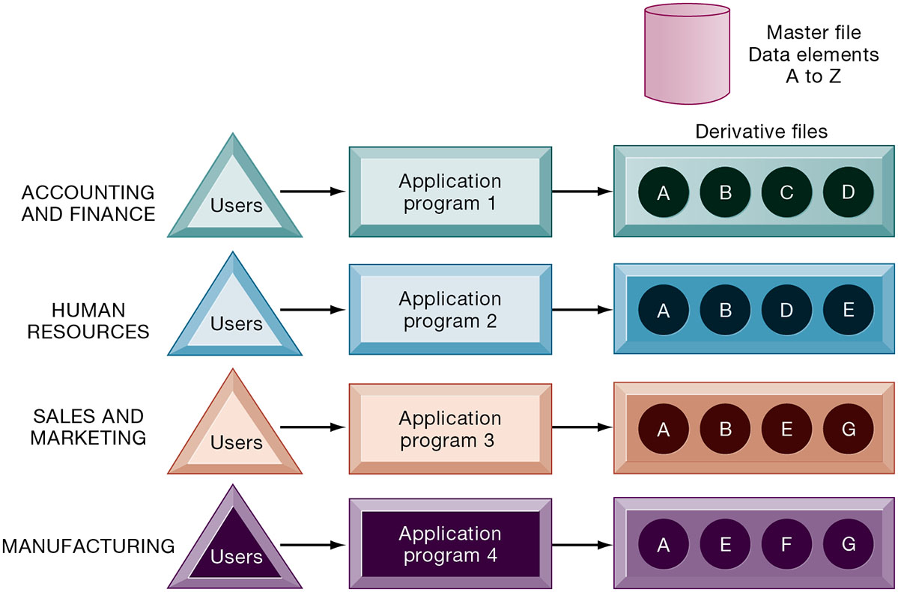
Figure 6.2 Traditional File Processing
Notes:
Figure 6.2, Page 215.
The use of a traditional approach to file processing encourages each functional area in a corporation to develop specialized applications. Each application requires a unique data file that is likely to be a subset of the master file. These subsets of the master file lead to data redundancy and inconsistency, processing inflexibility, and wasted storage resources.
This graphic illustrates a traditional environment, in which different business functions maintain separate data and applications to store and access that data. Ask students what kinds of data might be shared between accounting/finance and HR. What about between sales and marketing and manufacturing?
Full description: In the diagram, a cylinder shape represents the master file with data elements A to Z. Accounting and finance users, via Application program 1, require derivative files A, B, C, and D. Human resources users, via Application program 2, require derivative files A, B, D, and E. Sales and marketing users, via Application program 3, require derivative files A, B, E, and G. Manufacturing users, via Application program 4, require derivative files A, E, F, and G.

Slide 9
Database Management Systems
Database
Serves many applications by centralizing data and controlling redundant data
Database management system (D B M S)
Interfaces between applications and physical data files
Separates logical and physical views of data
Solves problems of traditional file environment
Controls redundancy
Eliminates inconsistency
Uncouples programs and data
Enables organization to centrally manage data and data security
Notes:
This slide defines and describes databases and DBMS. Ask students to explain what the difference is between a database and a DBMS. What is the physical view of data? What is the logical view of data?

Slide 10
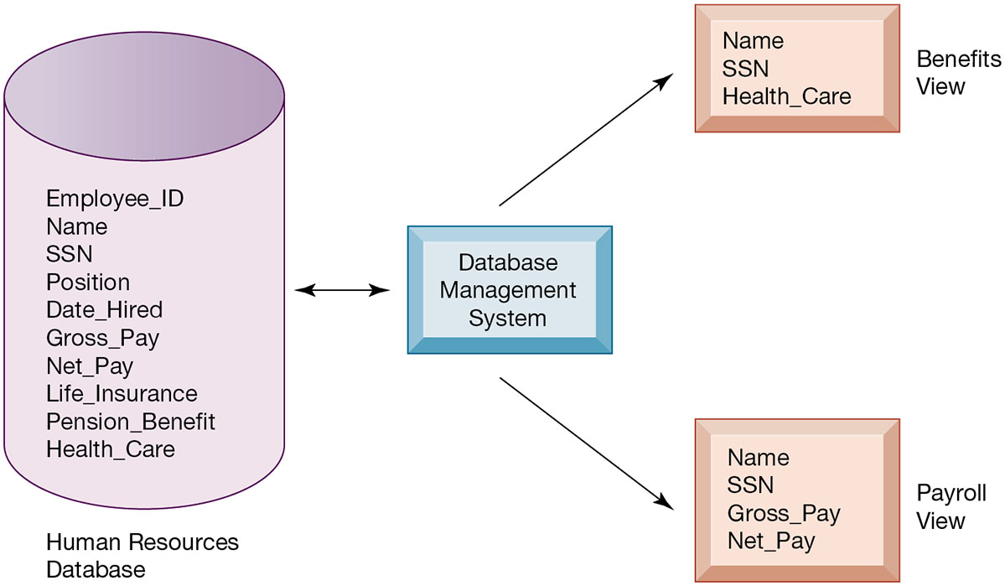
Figure 6.3 Human Resources Database with Multiple Views
Notes:
Figure 6.3, Page 217.
A single human resources database provides many different views of data, depending on the information requirements of the user. Illustrated here are two possible views, one of interest to a benefits specialist and one of interest to a member of the company’s payroll department.
This graphic illustrates what is meant by providing different logical views of data. The orange rectangles represent two different views in an HR database, one for reviewing employee benefits, the other for accessing payroll records. The students can think of the green cylinder as the physical view, which shows how the data are actually organized and stored on the physical media. The physical data do not change, but a DBMS can create many different logical views to suit different needs of users.
Full description: At the center of the diagram is the Database Management System. It has a reciprocal relationship with the Human Resources Database, which contains the following data: Employee I D, Name, S S N, Position, Date Hired, Gross Pay, Net Pay, Life Insurance, Pension Benefit, and Health Care. In the Benefits view, the database management systems provides the following data. Name, S S N, and Health Care. In the Payroll view, the database management system provides the following data. Name, S S N, Gross Pay, and Net Pay.

Slide 11
Relational D B M S
Represent data as two-dimensional tables
Each table contains data on entity and attributes
Table: grid of columns and rows
Rows (tuples): Records for different entities
Fields (columns): Represents attribute for entity
Key field: Field used to uniquely identify each record
Primary key: Field in table used for key fields
Foreign key: Primary key used in second table as look-up field to identify records from original table
Notes:
This slide introduces the most common type of DBMS in use with PCs, servers, and mainframes today, the relational database. Ask students why these DBMS are called relational. Ask students for examples of RDBMS software popular today and if they have every used any of this software. You can walk students through an example database that you have prepared in Access or use one of the exercise data tables found at the end of the chapter. Identify rows, fields, and primary key.

Slide 12
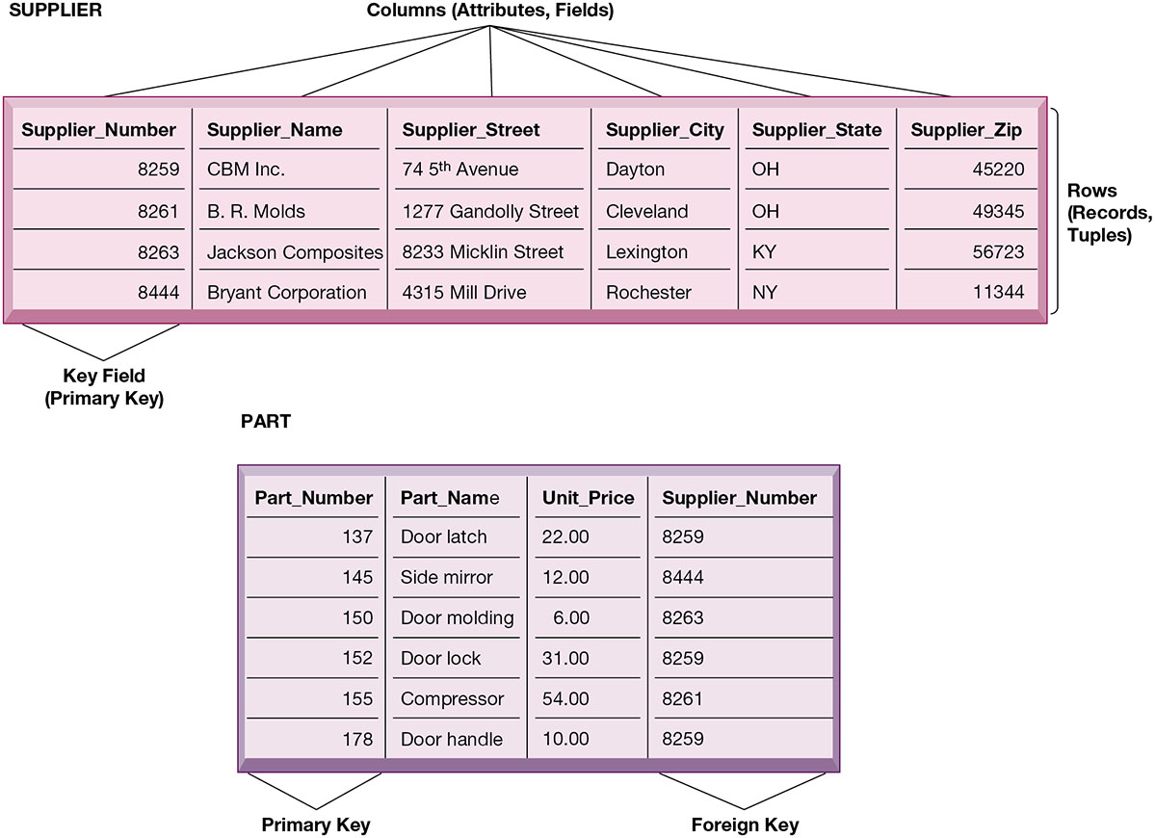
Figure 6.4 Relational Database Tables
Notes:
Figure 6.4, Page 219.
A relational database organizes data in the form of two-dimensional tables. Illustrated here are tables for the entities SUPPLIER and PART showing how they represent each entity and its attributes. Supplier_Number is a primary key for the SUPPLIER table and a foreign key for the PART table.
The graphic on this slide illustrates two tables in a relational DBMS. Ask students what the entity on this slide and the next are. The key field in the Supplier table is the Supplier number. What is the purpose of the key field?
Full description: Diagrams depict examples of relational database tables. The supplier table contains six columns, which are attributes or fields. They include supplier number, supplier name, street, city, state, and ZIP code. The rows in the table are filled with records, or tuples. The Supplier Name column is indicated as the Key Field. This primary key is the main identifier for that row of data. The part table contains four columns. The first column, Part Number, is identified as the primary key. The fourth column, Supplier Number, is identified as the foreign key.

Slide 13
Operations of a Relational D B M S
Three basic operations used to develop useful sets of data
SELECT
Creates subset of data of all records that meet stated criteria
JOIN
Combines relational tables to provide user with more information than available in individual tables
PROJECT
Creates subset of columns in table, creating tables with only the information specified
Notes:
This slide describes how information is retrieved from a relational database. These operations (SELECT, JOIN, PROJECT) are like programming statements and are used by DBMS developers. For example, looking at the last two slides showing the Supplier and Parts table, you would use what kind of an operation to show the Parts records along with the appropriate supplier's name? Access has wizards for these commands.

Slide 14
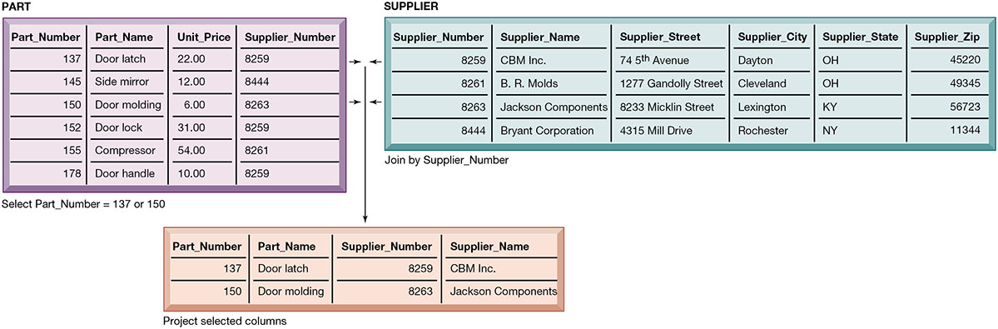
Figure 6.5 The Three Basic Operations of a Relational D B M S
Notes:
Figure 6.5, Page 220.
The select, join, and project operations enable data from two different tables to be combined and only selected attributes to be displayed.
This graphic illustrates the result from combining the SELECT, JOIN, and PROJECT operations to create a subset of data. The SELECT operation retrieves just those parts in the PART table whose part number is 137 or 150. The JOIN operation uses the foreign key of the Supplier Number provided by the PART table to locate supplier data from the Supplier Table for just those records selected in the SELECT operation. Finally, the PROJECT operation limits the columns to be shown to be simply the part number, part name, supplier number, and supplier name (orange rectangle).
Full description: A diagram depicts basic operations with tables of relational database management system. From the first database management table, Parts, two part numbers are, selected. The supplier numbers from those two parts in the Parts table are, joined, to the supplier numbers in the Supplier table. These selected data are displayed or, projected, in a third table.

Slide 15
Capabilities of Database Management Systems
Data definition capability
Data dictionary
Querying and reporting
Data manipulation language
Structured Query Language (S Q L)
Many D B M S have report generation capabilities for creating polished reports (Microsoft Access)
Notes:
This slide discusses the three main capabilities of a DBMS: its data definition capability, the data dictionary, and a data manipulation language.
Ask students to describe what characteristics of data would be stored by a data dictionary (name, description, size, type, format, other properties of a field). For a large company, a data dictionary might also store characteristics such as usage, ownership, authorization, security, users.
Note that the data manipulation language is the tool that requests operations such as SELECT and JOIN to be performed on data.

Slide 16
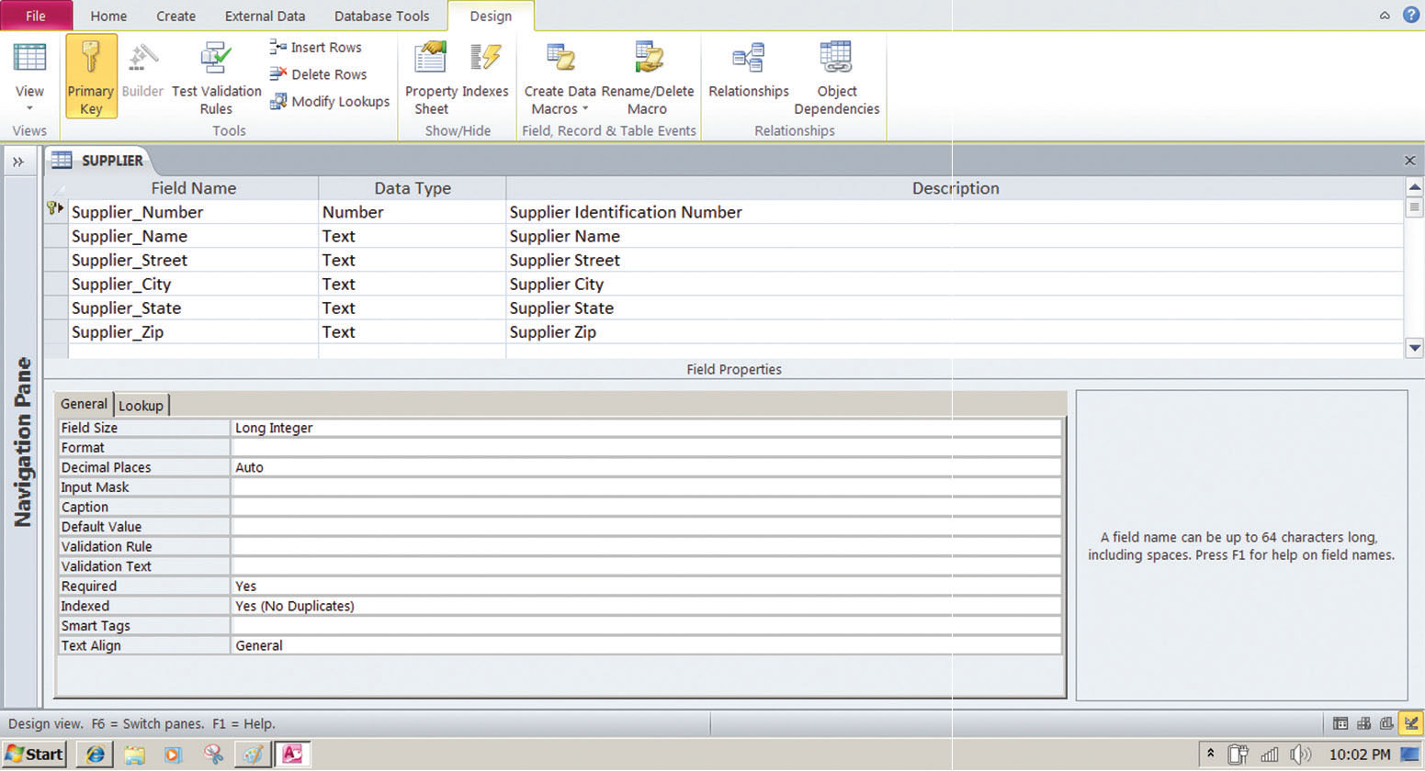
Figure 6.6 Access Data Dictionary Features
Notes:
Figure 6.6, Page 221.
Microsoft Access has a rudimentary data dictionary capability that displays information about the size, format, and other characteristics of each field in a database. Displayed here is the information maintained in the SUPPLIER table. The small key icon to the left of Supplier_Number indicates that it is a key field.
This graphic shows the data dictionary capability of Microsoft Access. For the field “Supplier Name” selected in the top pane, definitions can be configured in the General tab in the bottom pane. These General characteristics are Fields Size, Format, Input Mask, Caption, Default Value, Validation Rule, Validation Text, Required, Allow Zero Length, Indexed, Unicode Compression, IME mode, IME Sentence Mode, and Smart Tags.

Slide 17
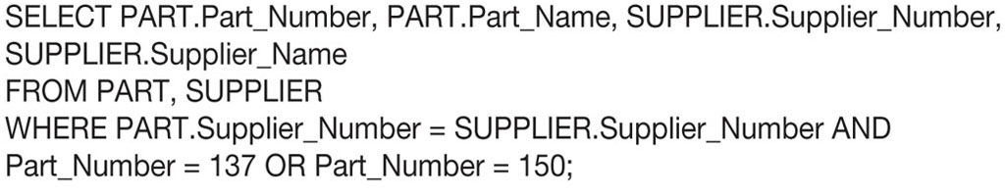
Figure 6.7 Example of an S Q L Query
Notes:
Figure 6.7, Page 222.
Illustrated here are the SQL statements for a query to select suppliers for parts 137 or 150. They produce a list with the same results as Figure 6.5.
This graphic shows an example SQL statement that would be used to retrieve data from a database. In this case, the SQL statement is retrieving records from the PART table illustrated on Slide 14 (Figure 6-5) whose Part Number is either 137 or 150.
Ask students to relate what each phrase of this statement is doing. (For example, the statement says to take the following columns: Part_Number, Part_Name, Supplier Number, Supplier Name, from the two tables Part and Supplier, when the following two conditions are true …)

Slide 18
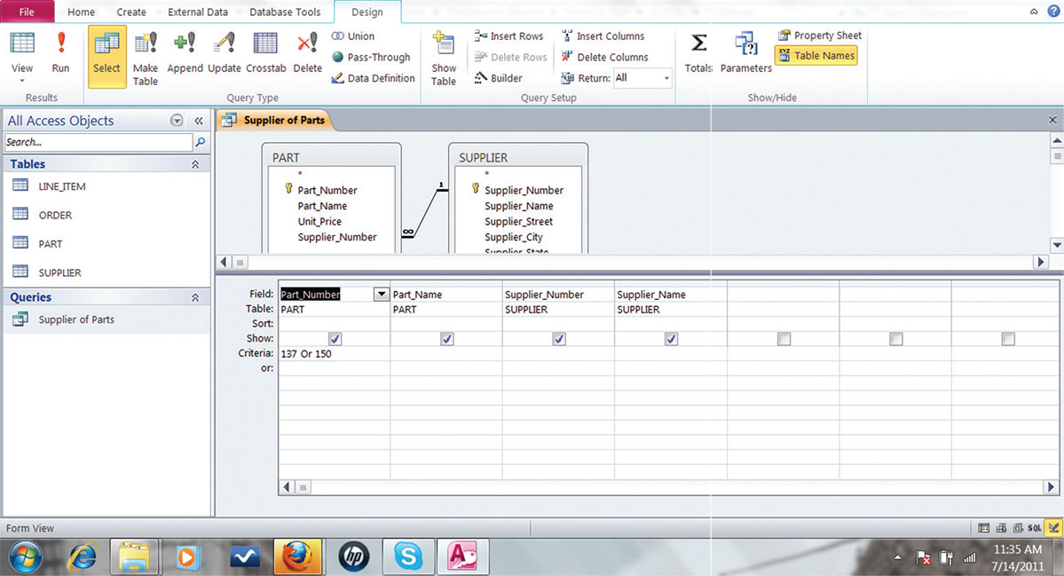
Figure 6.8 An Access Query
Notes:
Figure 6.8, Page 222.
Illustrated here is how the query in Figure 6.7 would be constructed using Microsoft Access querybuilding tools. It shows the tables, fields, and selection criteria used for the query.
This graphic illustrates a Microsoft Access query that performs the same operation as the SQL query in the last slide. The query pane at the bottom shows the fields that are requested (Fields), the relevant Tables (Table), the fields that will be displayed in the results (Show), and the criteria limiting the results to Part numbers 137 and 150 (Criteria).

Slide 19
Designing Databases
Conceptual design vs. physical design
Normalization
Streamlining complex groupings of data to minimize redundant data elements and awkward many-to-many relationships
Referential integrity
Rules used by R D B M S to ensure relationships between tables remain consistent
Entity-relationship diagram
A correct data model is essential for a system serving the business well
Notes:
This slide describes activities involved in designing a database. To create an efficient database, you must know what the relationships are among the various data elements, the types of data that will be stored, and how the organization will need to manage the data. Note that the conceptual database design is concerned with how the data elements will be grouped, what data in what tables will make the most efficient organizations.
This slide continues the discussion about designing databases. One technique database designers use in modeling the structure of the data is to use an entity-relationship diagram (illustrated on the next slide). Symbols on the diagram illustrate the types of relationships between entities. Ask students what different types of relationships there are between entities (one-to-one, one-to-many, many-to-many).

Slide 20
Figure 6.9 An Unnormalized Relation for Order
Notes:
Figure 6.9, Page 223.
An unnormalized relation contains repeating groups. For example, there can be many parts and suppliers for each order. There is only a one-to-one correspondence between Order_Number and Order_Date.
The graphics on this slide and the next illustrate the process of normalization. Here, one table lists the relevant data elements for the entity ORDER. These include all of the details about the order, the part, the supplier.
An order can include more than one part, and it may be that several parts are supplied by the same supplier. However, using this table, the supplier’s name, and other information might need to be stored several times on the order list.
Full description: A Diagram depicts a relation before normalization. The Diagram contains a row of boxes, each containing a group: Order Number, Order Date, Part Number, Part Name, Unit Price, Part Quantity, Supplier Number, Supplier Name, Supplier Street, Supplier City, Supplier State, and Supplier Zip.

Slide 21
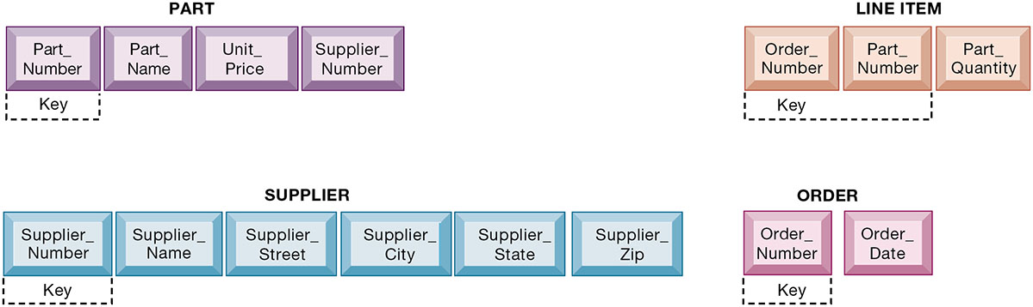
Figure 6.10 Normalized Tables Created from Order
Notes:
Figure 6.10, Page 223.
After normalization, the original relation ORDER has been broken down into four smaller relations. The relation ORDER is left with only two attributes, and the relation LINE_ITEM has a combined, or concatenated, key consisting of Order_Number and Part_Number.
This graphic shows the normalized tables. The Order table has been broken down into four smaller, related tables. Notice that the Order table contains only two unique attributes, Order Number and Order Date. The multiple items ordered are stored using the Line_Item table. The normalization means that very little data has to be duplicated when creating orders, most of the information can be retrieved by using keys to the Part and Supplier tables.
It is important to note that relational database systems try to enforce referential integrity rules to ensure that relationships between coupled tables remain consistent. When one table has a foreign key that points to another table, you may not add a record to the table with the foreign key unless there is a corresponding record in the linked table. For example, foreign key Supplier_Number links the PART table to the SUPPLIER table. Referential integrity means that a new part can’t be added to the part table without a valid supplier number existing in the Supplier table. It also means that if a supplier is deleted, any corresponding parts must be deleted also.
Full description: A Diagram depicts a relation after normalization. In the diagram, the, Part, relations include Part Number, Part Name, Unit Price, and Supplier Number. The key for this relation is Part Number. The, Line Item, relation contains Order Number, Part Number, and Part Quantity. The keys for this relation are Order Number and Part Number. The, Supplier, relation contains Supplier Number, Supplier Name, Supplier Street, Supplier City, Supplier State, and Supplier Zip. The key for this relation is Supplier Number. The, Order, relation contains Order Number and Order Date. The key for this relation is Order Number.

Slide 22
Figure 6.11 An Entity-Relationship Diagram
Notes:
Figure 6.11, Page 224.
This diagram shows the relationships between the entities SUPPLIER, PART, LINE_ITEM, and ORDER that might be used to model the database in Figure 6.10.
This graphic shows an example of an entity-relationship diagram. It shows that one ORDER can contain many LINE_ITEMs. (A PART can be ordered many times and appear many times as a line item in a single order.) Each LINE ITEM can contain only one PART. Each PART can have only one SUPPLIER, but many PARTs can be provided by the same SUPPLIER.
Full description: An entity relationship diagram consists of four parts, listed as follows. Part 1, labeled, supplier, both provides to and is supplied by part 2, labeled, part. Part 2, part, both is ordered by and contains part 3, labeled, line item. Part 3, line item, both belongs to and includes part 4, labeled, order.

Slide 23
Non-Relational Databases and Databases in the Cloud
Non-relational databases: “No S Q L”
More flexible data model
Data sets stored across distributed machines
Easier to scale
Handle large volumes of unstructured and structured data
Databases in the cloud
Appeal to start-ups, smaller businesses
Amazon Relational Database Service, Microsoft S Q L Azure
Private clouds
Notes:
This slide discusses other types of DBMS. Ask students why one would want to store social media data in a non-relational database? The answer: social media involves many different file types, and the information is not easily organized into tables of columns and rows. Another option for businesses is to license database software “from the cloud.” What would be an advantage to using a database service? (A primary answer is scalability—you pay only for the exact services you need.)

Slide 24
Blockchain
Distributed ledgers in a peer-to-peer distributed database
Maintains a growing list of records and transactions shared by all
Encryption used to identify participants and transactions
Used for financial transactions, supply chain, and medical records
Foundation of Bitcoin, and other crypto currencies
Notes:
Blockchain is a transaction database that uses encryption to ensure the validity of transactions among the parties in the system. Blockchain is discussed more fully in Chapter 6 Securing Information Systems.

Slide 25
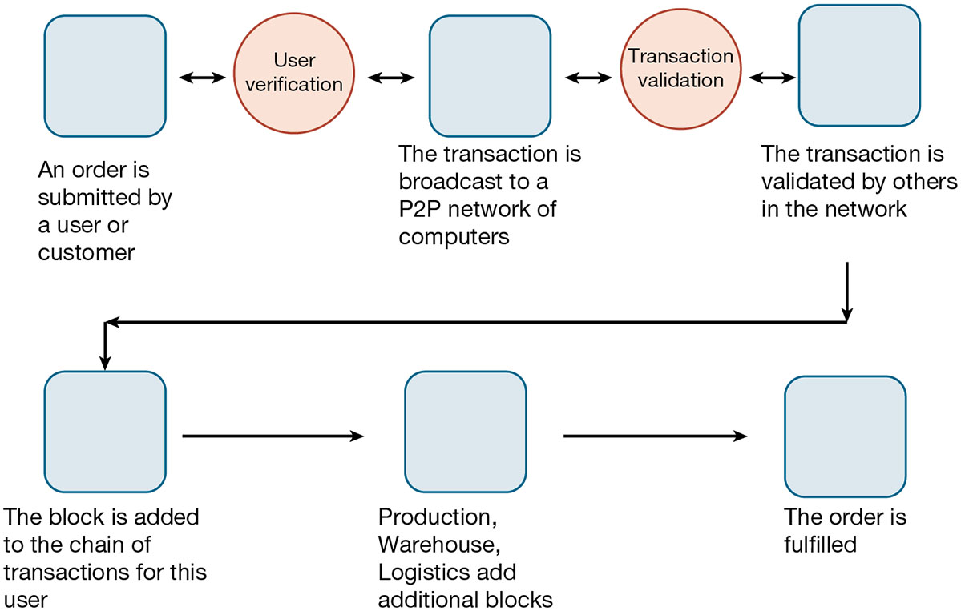
Figure 6.12 How Blockchain Works
Notes:
Figure 6.11, Page 226.
A blockchain system is a distributed database that records transactions in a peer-to-peer network of computers
Full description: The diagram illustrates the stages of fulfilling a transaction using blockchain. 1. An order is submitted by a user or customer. 2. User verification. 3. The transaction is broadcast to a P 2 P network of computers. 4. Transaction validation. 5. The transaction is validated by others in the network. 6. The block is added to the chain of transactions for this user. 7. Production, warehouse, and logistics add additional blocks. 8. The order is fulfilled.

Slide 26
The Challenge of Big Data
Big data
Massive sets of unstructured/semi-structured data from web traffic, social media, sensors, and so on
Volumes too great for typical D B M S
Petabytes, exabytes of data
Can reveal more patterns, relationships and anomalies
Requires new tools and technologies to manage and analyze
Notes:
This slide discusses how very large databases are used to produce valuable information for firms. The text gives the example of how, by analyzing data from customer credit card purchases, Louise’s Trattoria, a Los Angeles restaurant chain, learned that quality was more important than price for most of its customers, who were college educated and liked fine wine. The chain responded to this information by introducing vegetarian dishes, more seafood selections, and more expensive wines, raising sales by more than 10%.

Slide 27
Business Intelligence Infrastructure (1 of 3)
Array of tools for obtaining information from separate systems and from big data
Data warehouse
Stores current and historical data from many core operational transaction systems
Consolidates and standardizes information for use across enterprise, but data cannot be altered
Provides analysis and reporting tools
Notes:
Business intelligence is a very amorphous notion that is not well defined. In this course we refer instead to a “business intelligence” environment which is composed of many different components (including both technology and management dimensions).
This slide discusses the use of data warehouses and data marts by firms.
Ask students why having a data warehouse is an advantage for firms hoping to perform business analyses on the data? Why does there have to be a repository of data that is separate from the transaction database?

Slide 28
Business Intelligence Infrastructure (2 of 3)
Data marts
Subset of data warehouse
Typically focus on single subject or line of business
Hadoop
Enables distributed parallel processing of big data across inexpensive computers
Key services
Hadoop Distributed File System (H D F S): data storage
MapReduce: breaks data into clusters for work
Hbase: No S Q L database
Used Yahoo, NextBio
Notes:
Hadoop is one of the tools used by search engines such as Google and Bing to rapidly search billions of web pages and find those which appear to be the most relevant to a user’s search query. This task is accomplished in a few milliseconds by distributing the data and the processing across tens of thousands of processors, and then pulling the results together to produce a web search page for users. Hadoop is far faster than SQL and traditional centralized databases running on very large mainframes or supercomputers. Hadoop is an open source software library.

Slide 29
Business Intelligence Infrastructure (3 of 3)
In-memory computing
Used in big data analysis
Uses computers main memory (R A M) for data storage to avoid delays in retrieving data from disk storage
Can reduce hours/days of processing to seconds
Requires optimized hardware
Analytic platforms
High-speed platforms using both relational and non-relational tools optimized for large datasets

Slide 30
Interactive Session: Technology: Kraft Heinz Finds a New Recipe for Analyzing Its Data
Class discussion
Identify the problem in this case study. To what extent was it a technology problem? Were any management and organizational factors involved?
How was information technology affecting business performance at Kraft Heinz?
How did new technology provide a solution to the problem? How effective was the solution?
Identify the management, organizational, and technology factors that had to be addressed in selecting and implementing Kraft-Heinz’s new data warehouse solution.

Slide 31
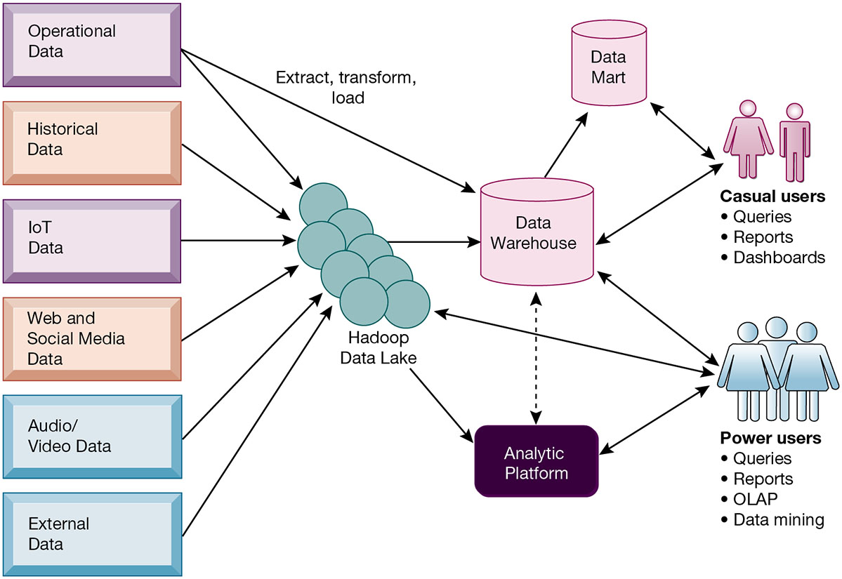
Figure 6.13 Contemporary Business Intelligence Infrastructure
Notes:
Figure 6.12, Page 232.
A contemporary business intelligence infrastructure features capabilities and tools to manage and analyze large quantities and different types of data from multiple sources. Easy-to-use query and reporting tools for casual business users and more sophisticated analytical toolsets for power users are included.
This graphic illustrates the components of a data warehouse system. It shows that the data warehouse extracts data from multiple sources, both internal and external, including a Hadoop cluster, and transforms it as needed for the data warehouse systems. An analytic platform has tools for power users, including reporting, OLAP, and data mining, to extract meaningful information from the data warehouse and Hadoop cluster. A subset of the data warehouse is collected in a data mart for casual groups of users.
Full description: In a diagram, arrows point from operational data, historical data, machine data, web data, audio video data, and external data to Hadoop cluster. Two arrows extend from the Hadoop cluster, one into analytic platform and one in data warehouse. From operational data, another arrow labeled, extract, transform, load, points into data warehouse. From the data warehouse, an arrow points to data mart. An arrow points from data mart to casual users, which includes queries, reports, and dashboards, and vice versa. Another arrow points from data warehouse to casual users, and vice versa. Arrows point from power users, which includes queries, reports, O L A P, and data mining, to analytic platform, data warehouse, and Hadoop cluster, and vice versa. A dashed bidirectional line is found between data warehouse and analytic platform.

Slide 32
Analytical Tools: Relationships, Patterns, Trends
Tools for consolidating, analyzing, and providing access to vast amounts of data to help users make better business decisions
Multidimensional data analysis (O L A P)
Data mining
Text mining
Web mining
Notes:
This slide describes the role and types of analytical tools and techniques for finding useful information and relationships in large data sets.

Slide 33
Online Analytical Processing (O L A P)
Supports multidimensional data analysis
Viewing data using multiple dimensions
Each aspect of information (product, pricing, cost, region, time period) is different dimension
Example: How many washers sold in the East in June compared with other regions?
O L A P enables rapid, online answers to ad hoc queries
Notes:
This slide discusses online analytical processing, one of the three principle tools for gathering business intelligence.
Ask students to come up with additional examples of what a multidimensional query might be.

Slide 34
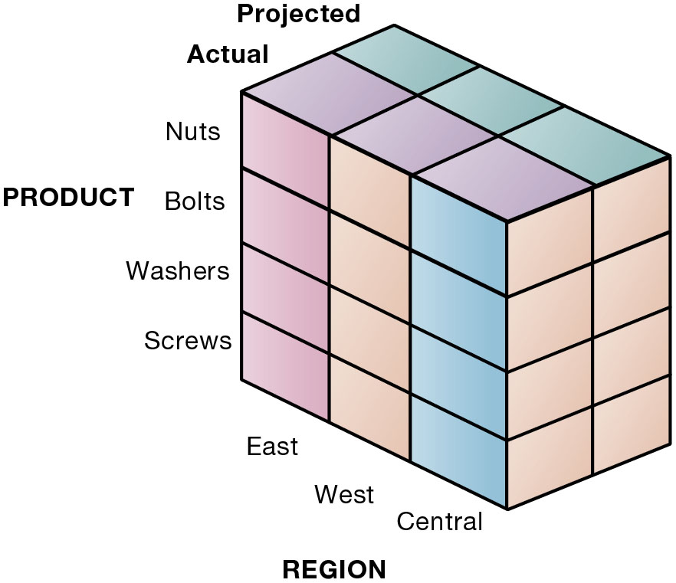
Figure 6.14 Multidimensional Data Model
Notes:
Figure 6.14, Page 233.
This view shows product versus region. If you rotate the cube 90 degrees, the face that will show is product versus actual and projected sales. If you rotate the cube 90 degrees again, you will see region versus actual and projected sales. Other views are possible.
This graphic illustrates the concept of dimensions as it relates to data. Product is one dimension. East is a dimension, and projected and actual sales are two more dimensions. Altogether, we are trying to analyze four dimensions. The business question is: In the Eastern region, what are the actual and projected sales of our products (nuts, bolts, washers, and screws)? Sometimes referred to as a “data cube,” the graphic can depict this four dimensional view of the data. More importantly, when compared to a spreadsheet model of the same data, a graphical data cube is much faster, easier to understand and visualize the relationships.

Slide 35
Data Mining
Finds hidden patterns, relationships in datasets
Example: customer buying patterns
Infers rules to predict future behavior
Types of information obtainable from data mining:
Associations
Sequences
Classification
Clustering
Forecasting
Notes:
This slide discusses another business intelligence tool driven by databases, data mining. Data mining provides insights into data that cannot be discovered through OLAP, by inferring rules from patterns in data.
Ask students to describe the types of information listed:
Associations: Occurrences linked to single event
Sequences: Events linked over time
Classification: Recognizes patterns that describe group to which item belongs
Clustering: Similar to classification when no groups have been defined; finds groupings within data
Forecasting: Uses series of existing values to forecast what other values will be

Slide 36
Text Mining and Web Mining
Text mining
Extracts key elements from large unstructured data sets
Sentiment analysis software
Web mining
Discovery and analysis of useful patterns and information from web
Web content mining
Web structure mining
Web usage mining
Notes:
Whereas data mining describes analysis of data in databases, there are other types of information that can be “mined,” such as text mining and web mining. Ask students what other types of unstructured textual data sets a company might store, and what kind of useful information might be extracted from them.
This slide continues the exploration of mining stored data for valuable information. In addition to text mining, there are several ways to mine information on the web. The text uses the example of marketers using Google Trends and Google Insights for Search services, which track the popularity of various words and phrases used in Google search queries, to learn what people are interested in and what they are interested in buying. What type of web mining is this? Why might a marketer be interested in the number of web pages that link to a site.

Slide 37
Databases and the Web
Many companies use the web to make some internal databases available to customers or partners
Typical configuration includes:
Web server
Application server/middleware/C G I scripts
Database server (hosting D B M S)
Advantages of using the web for database access:
Ease of use of browser software
Web interface requires few or no changes to database
Inexpensive to add web interface to system
Notes:
This slide looks at how companies utilize the web to access company databases. Ask students to describe the flow of information from a company’s databases to the web page a user is accessing data on. Why is browser software easy to use? Why is it less expensive to add a web interface to a database-driven information system?

Slide 38
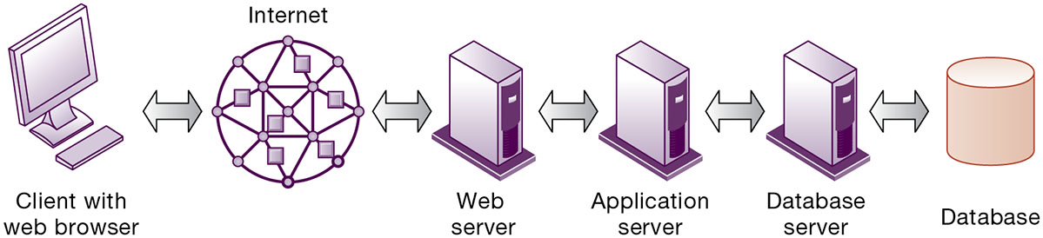
Figure 6.15 Linking Internal Databases to the Web
Notes:
Figure 6.15, Page 235.
Users access an organization’s internal database through the web using their desktop PC browsers or mobile apps.
Full description: In the diagram, from left to right, are six elements of connecting to the web’s database, named as follows. Client with Web browser. Internet. Web server. Application server. Database server. Database. Each of these elements is linked to its neighbor by a bidirectional arrow.

Slide 39
Establishing an Information Policy
Firm’s rules, procedures, roles for sharing, managing, standardizing data
Data administration
Establishes policies and procedures to manage data
Data governance
Deals with policies and processes for managing availability, usability, integrity, and security of data, especially regarding government regulations
Database administration
Creating and maintaining database
Notes:
This slide discusses the firm’s need for an information policy in order to ensure that firm data is accurate, reliable, and readily available. Note that although the database administration group establishes and creates the physical database, the data administration function is responsible for logical database design and data dictionary development. Why would this function be better placed with the data administration group?

Slide 40
Ensuring Data Quality
More than 25 percent of critical data in Fortune 1000 company databases are inaccurate or incomplete
Before new database is in place, a firm must:
Identify and correct faulty data
Establish better routines for editing data once database in operation
Data quality audit
Data cleansing
Notes:
This slide discusses the importance of data quality. Ask students for personal examples of what happens when a company’s data is faulty. The text provides an example of one study finding that 10 to 25 percent of customer and prospect records contain critical data errors. Has anyone in class directly experienced a problem with the accuracy of data about them stored on computer systems?

Slide 41
Interactive Session: Organizations: Databases Where the Data Aren’t There
Class discussion
Define the problem described in this case. How serious a problem is it?
What management, organization, and technology factors contributed to this problem?
What is the political and social impact of incomplete recordkeeping in the F B I N C I C and N I C S databases?

Slide 42
How Will M I S Help My Career?
The Company: Mega Midwest Power
Position Description: Entry-level data analyst
Job Requirements
Interview Questions
Author Tips

Slide 43

Copyright
This work is protected by United States copyright laws and is provided solely for the use of instructors in teaching their courses and assessing student learning. Dissemination or sale of any part of this work (including on the World Wide Web) will destroy the integrity of the work and is not permitted. The work and materials from it should never be made available to students except by instructors using the accompanying text in their classes. All recipients of this work are expected to abide by these restrictions and to honor the intended pedagogical purposes and the needs of other instructors who rely on these materials.

